Slide 1
Assignment
Read the dataset "prostrate.csv" that is provided to you. Build a suitable decision tree model using R and develop a predictive model for predicting the status of a patient based on his/her predictor information. Plot the decision tree and develop some metrics to determine the accuracy of your classification model

Slide 2
Decision Tree
In a parametric model, you know which model exactly you will fit to the data, e.g., linear regression line. e.g. y_i= beta_0 + beta_1 x_i + e_i (after training parameters emerge)
In a non-parametric model, however, the data tells you what the 'regression' should look like e.g. y_i= f(x_i) + e_i
Decision Tree is a non-parametric model
Decision trees use a tree-logic to make predictions
Classification trees → if response is categorical; Regression trees →if response is continuous
Classification trees → predict class probabilities
Regression trees → predict numeric values

Slide 3
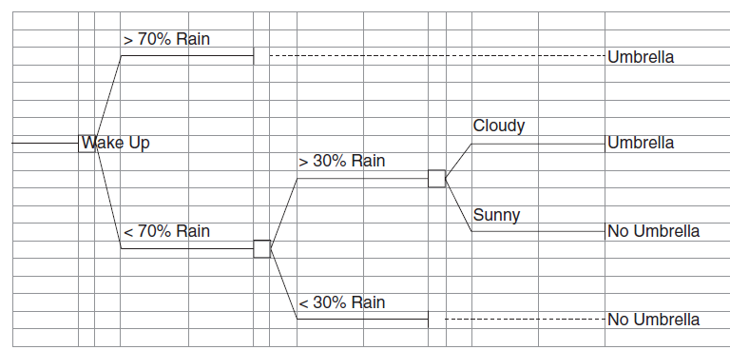

Decision Tree
Example : Whether or not to take an umbrella.
Decision depends on → weather, rain probability and sunny or cloudy
For example, if the forecast predicts rain with a probability between 30% and 70% and if it is cloudy when you leave the house, you better take an umbrella
Each decision defines a node. The final prediction is made at a leaf or terminal node. A given set of covariates x dictates your path through the tree nodes, eventually leading to a leaf (or terminal) node at the end of the tree.

Slide 4
Decision Tree
In example, path through tree and splits at nodes are assumed given.
In actual applications, one has a training set with known outcomes, and path through tree and splits need to be estimated.
How many decision nodes should there be?
What is the order of making the decisions?
There is a huge set of possible tree configurations.
We solve problem by thinking recursively and by splitting a node into just two branches.
We start by splitting data into 2 branches that make different decisions about response y.
Then we take each new partition and split it again into 2, and again, and again, and so on.

Slide 5
Decision Tree
Growing a tree with the CART algorithm involves the following steps
Find split location in x that minimizes measure of node impurity of the tree
If, for example, set of covariates comprises five variables
we try each variable one at a time
find the best two-way split on each variable
select variable and split that minimize the node impurity of tree.
Each child node of the split tree contains a subset of the data
View each child as a new data set, and grow the tree from there.
Stop growing when no split reduces the node impurity
Instead of being based on (regression) coefficients, the predictions (the y in the regression tree, and the predicted probabilities p in the classification tree) are functions of decisions at
the decision nodes
mytree = tree(y ~ x1 + x2 + x3…, data=mydata)

Slide 6
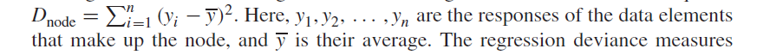
Decision Tree
mytree = tree(y ~ x1 + x2 + x3…, data=mydata)
Additional parameters for tree function
Requirements on minimum leaf size (number of observations in a leaf),
Minimum improvement in node impurity
Maximum depth of the tree
We need a measure of node impurity that guides our splitting of the data set that tells whether it makes sense to split a certain node even further
For regression tree regression deviance at a given node of tree is the sum of squares
The regression deviance measures the node impurity (disorder) and assesses the homogeneity of the responses within the node
Small values of the deviance reflect homogeneity and node purity (or node order).

Slide 7
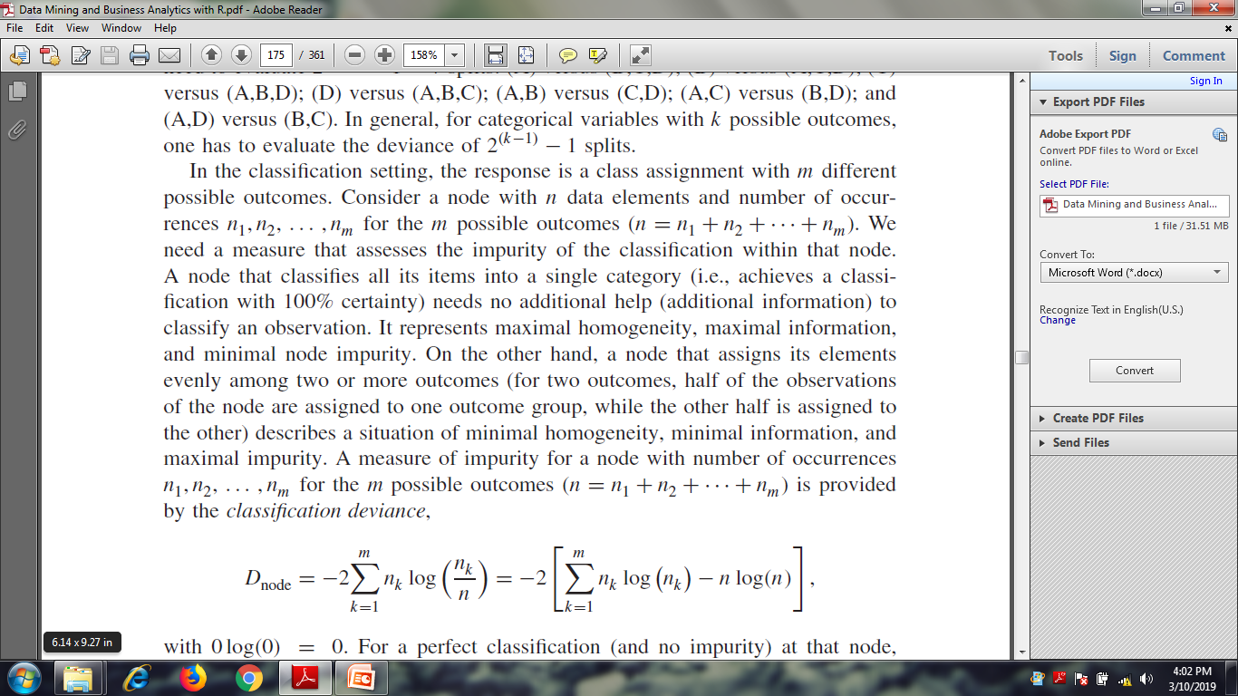
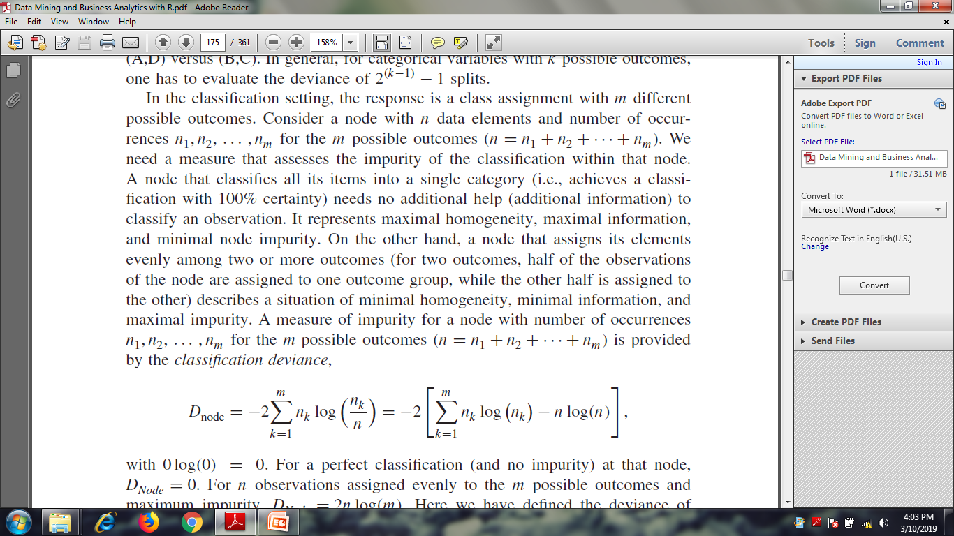
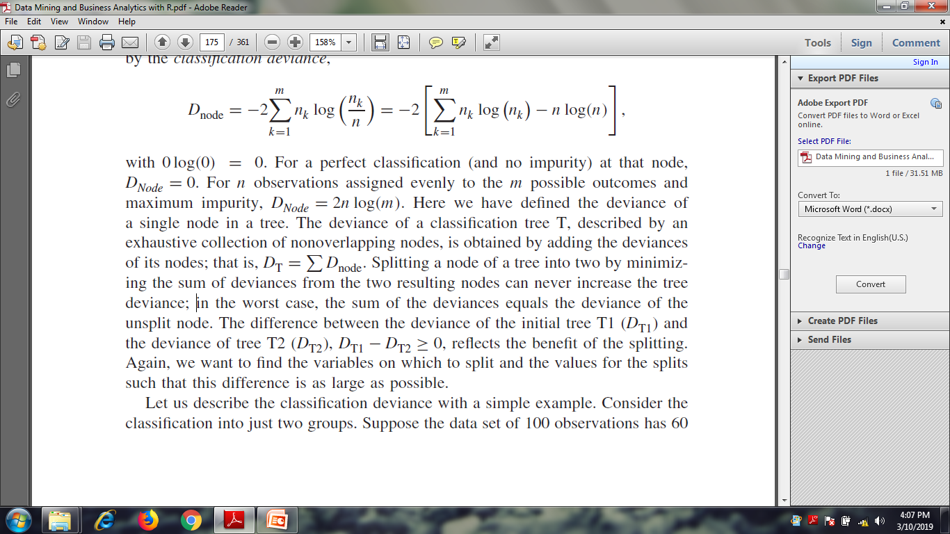
Decision Tree
For a perfect classification (and no impurity) at that node, DNode = 0.
Splitting a node of a tree into two by minimizing the sum of deviances from the two resulting nodes can never increase the tree deviance;
we want to find the variables on which to split and the values for the splits such that this difference is as large as possible.

Slide 8
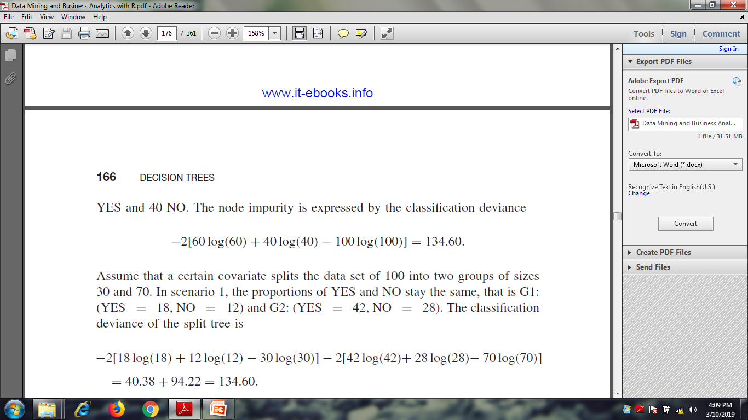
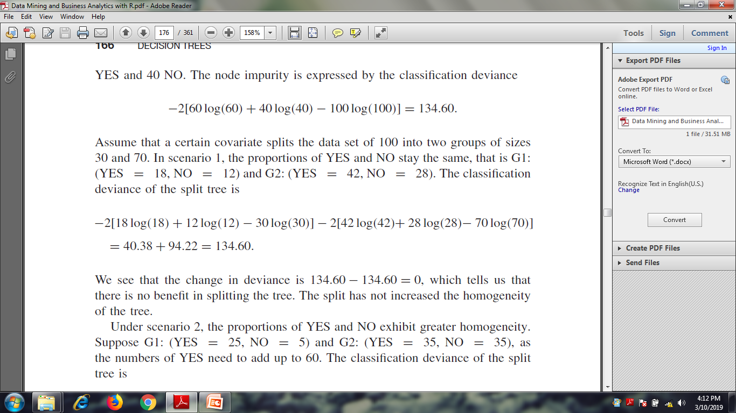
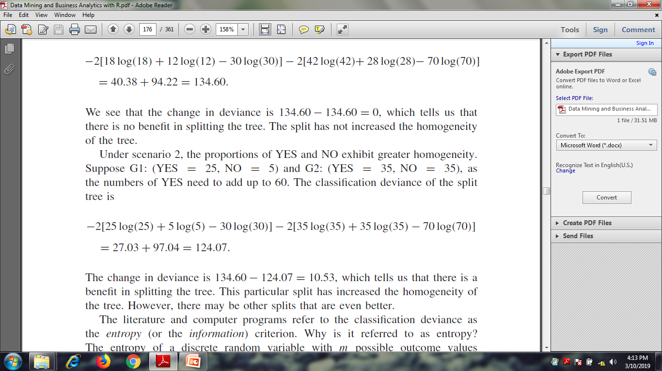
Decision Tree
Suppose the data set of 100 observations has 60 YES and 40 NO. The node impurity is expressed by the classification deviance
Node as well as tree deviance

Slide 9
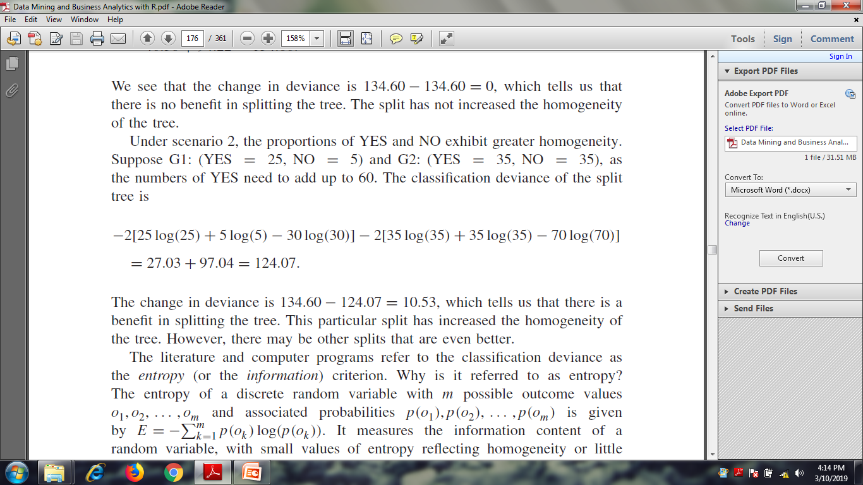
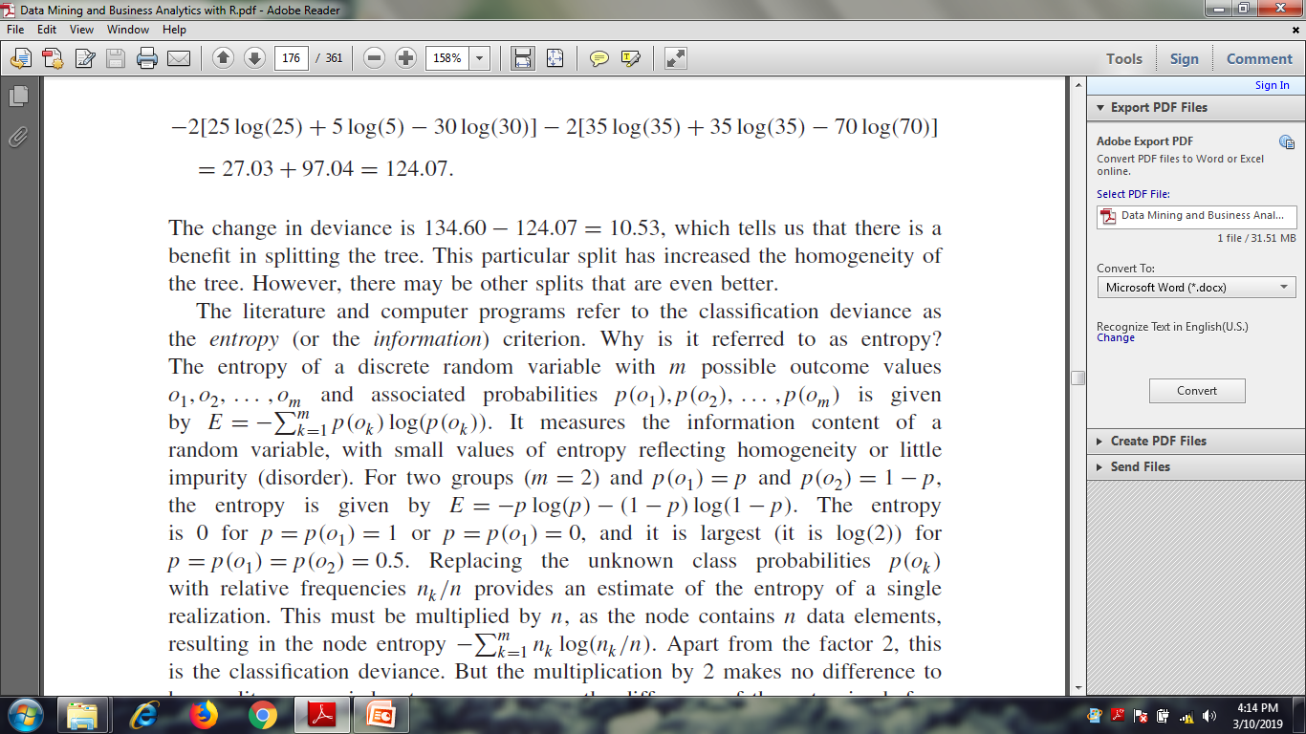
Decision Tree

Slide 10
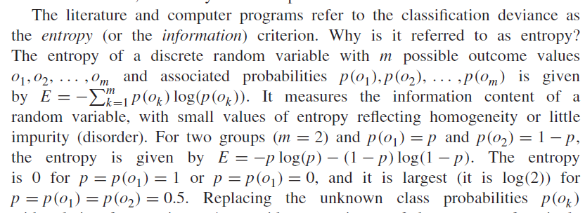
Decision Tree

Slide 11
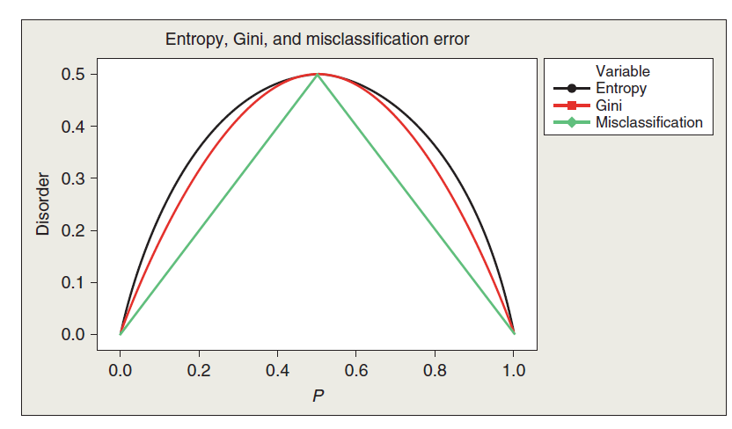
Decision Tree

Slide 12
Decision Tree
EXAMPLE : PROSTATE CANCER
Biopsy results are available for n = 97 men of various ages.
The information includes
Gleason Score (gleason): scores are assigned to the two most common tumor patterns, ranging from 2 to 10; in this data set, the range is from 6 to 9.
Prostate-specific antigen (psa): laboratory results on protein production.
Capsular penetration (cp): reach of cancer into gland lining.
Benign prostatic hyperplasia amount (bph): size of prostate.
The goal is to predict tumor log volume (which measures the tumor’s size/spread). The predicted tumor size affects the patients’ treatment options, which include chemotherapy, radiation treatment, and surgical removal of the prostate.

Slide 13
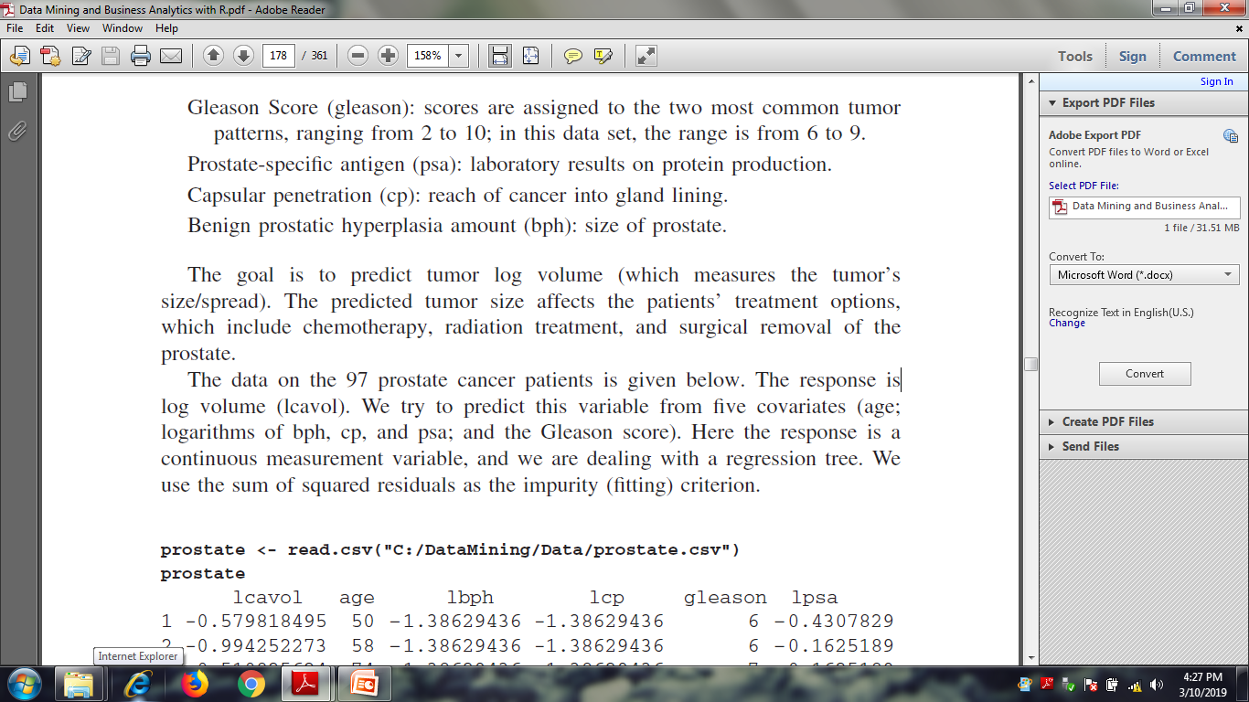
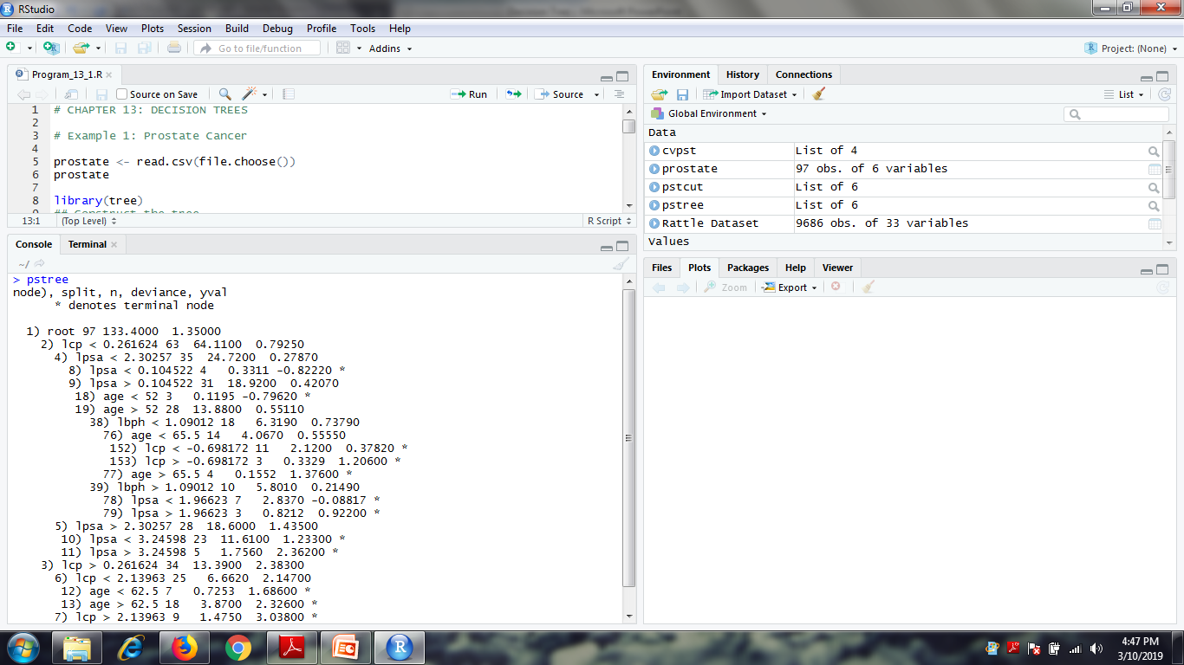
Decision Tree
prostate <- read.csv(file.choose())
prostate
library(tree)
pstree <- tree(lcavol ~., data=prostate, mincut=1)
# The minimum number of observations to include in either child node =1
pstree

Slide 14
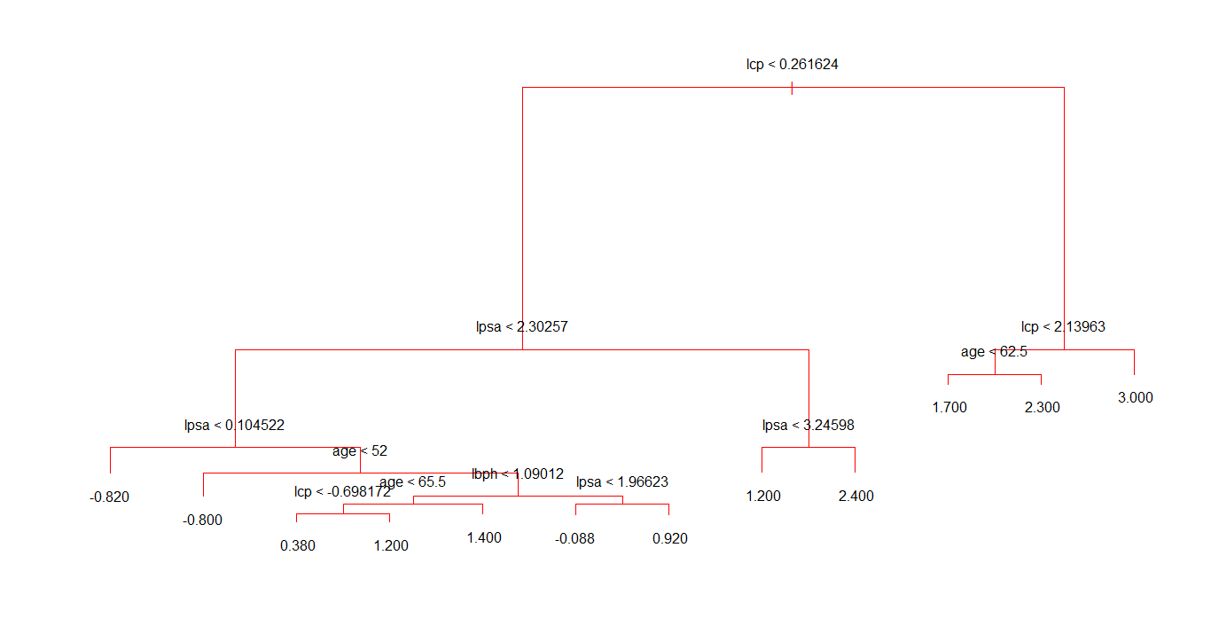
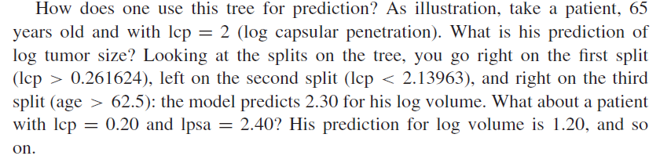
Decision Tree
plot(pstree, col=8)
text(pstree, digits=2)

Slide 15
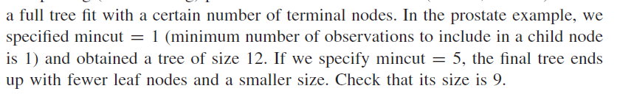
Decision Tree
If the splitting algorithm is not stopped, the tree algorithm will ultimately “extract” all information from the data, including information that is not and cannot be predicted in the
population with the current set of predictor – this is called Overfitting
For example, if we can predict 90% of all cases correctly from 10 splits, and 90.1% of all cases from 11 splits, then it obviously makes little sense to add that 11th split to the tree

Slide 16
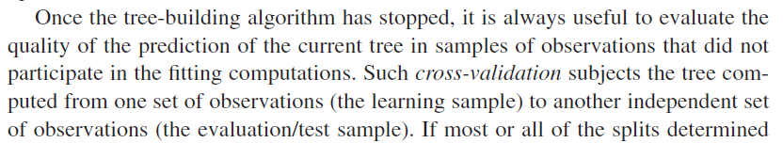
Decision Tree
If one sees a big difference between the in-sample and the out-of-sample performance, one can infer that the selected tree is not very useful, and not of the “right size.”
Pruning back the tree is another good defense against overfitting
We prune the tree by removing splits from the bottom up. At each step, we remove the split that contributes least to deviance reduction, thus reversing CART’s growth process
Each prune step produces candidate tree model, now of reduced size (number of terminal )
our criterion for pruning the tree is the minimization of the deviance of the tree.
Using the tree to prune that used training data-set will be worse since we buit the tree with stepwise reduction in deviance

Slide 17
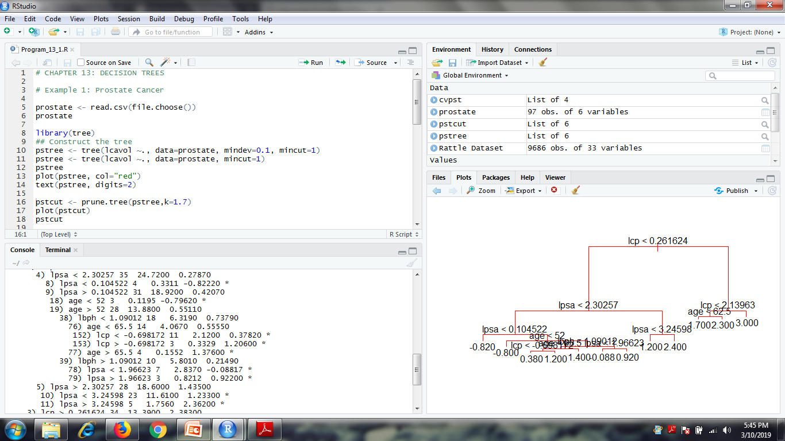
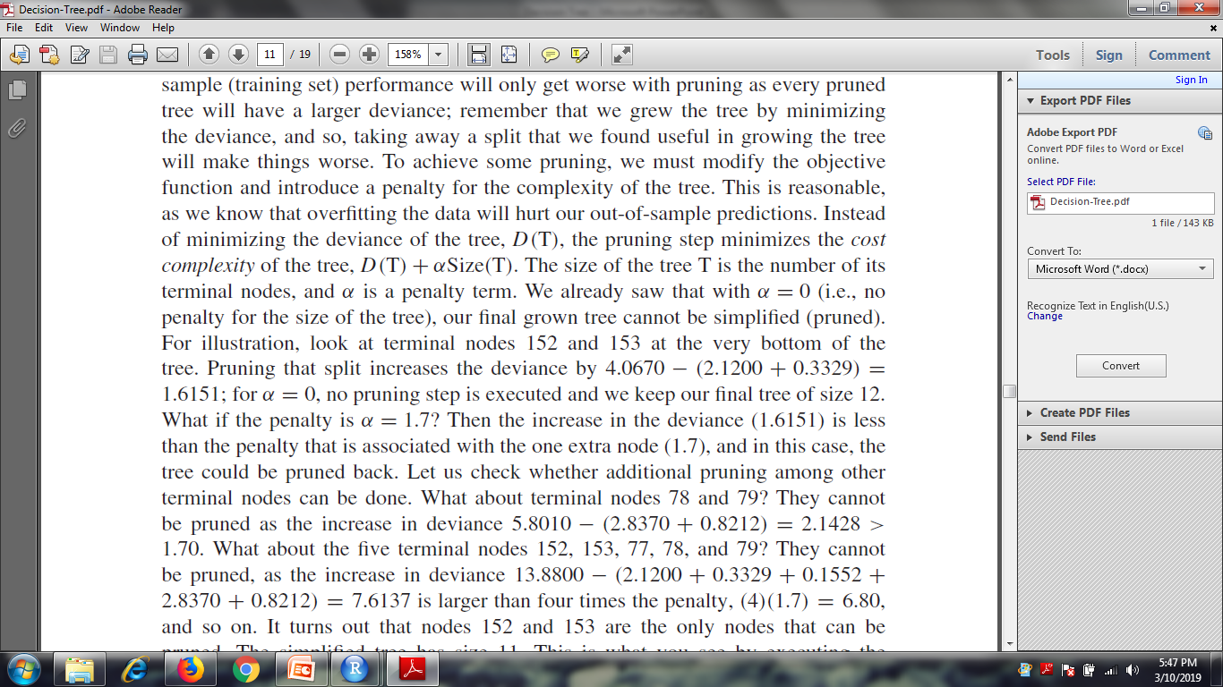
Decision Tree
To achieve some pruning, we must modify the objective function and introduce a penalty for the complexity of the tree
Instead of minimizing the deviance of the tree, D(T), the pruning step minimizes the cost
complexity of the tree, D(T) + αSize(T).
The size of the tree T is the number of its terminal nodes, and α is a penalty term

Slide 18
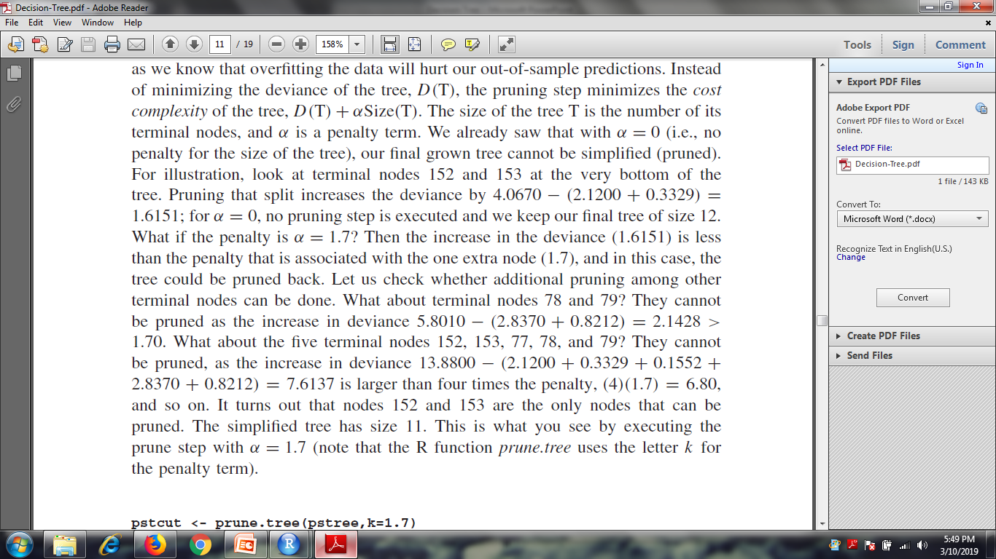
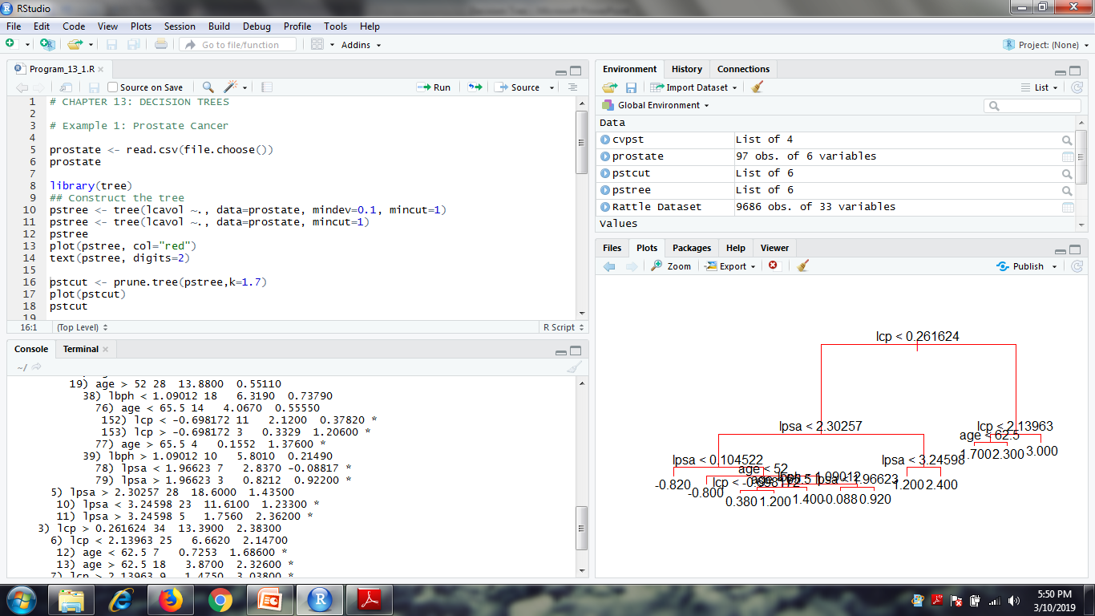
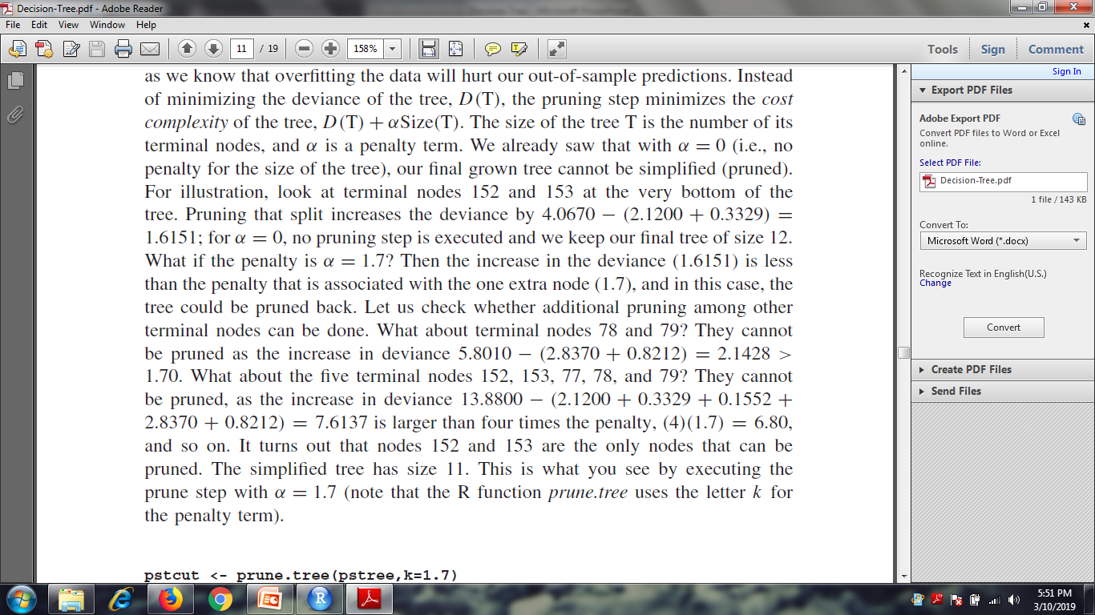
Decision Tree

Slide 19
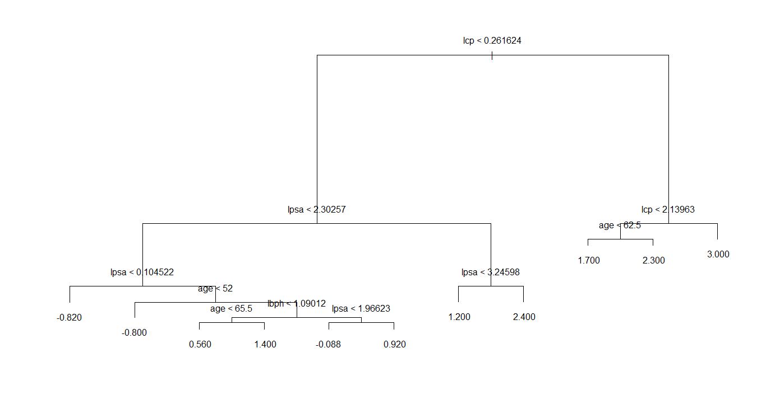
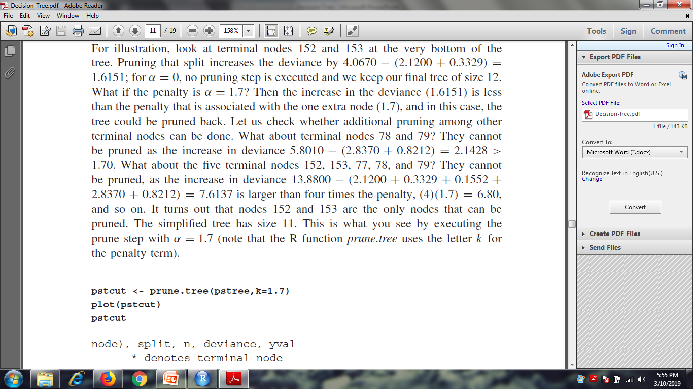
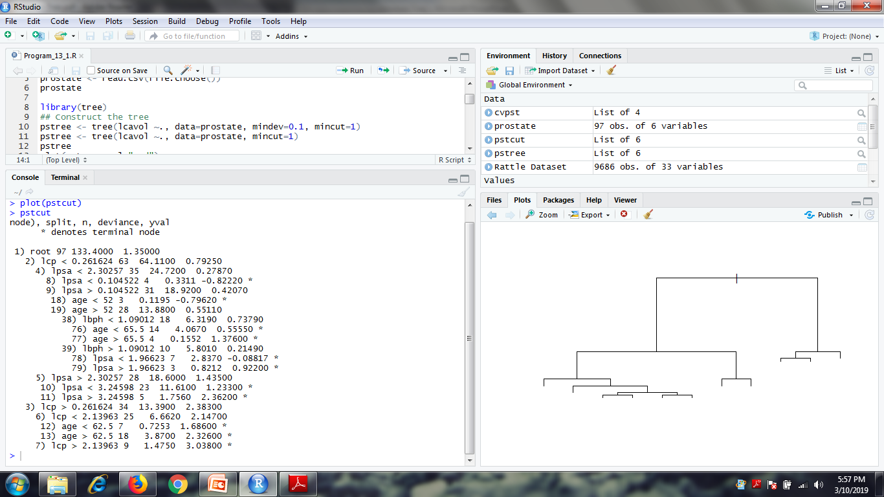
Decision Tree

Slide 20
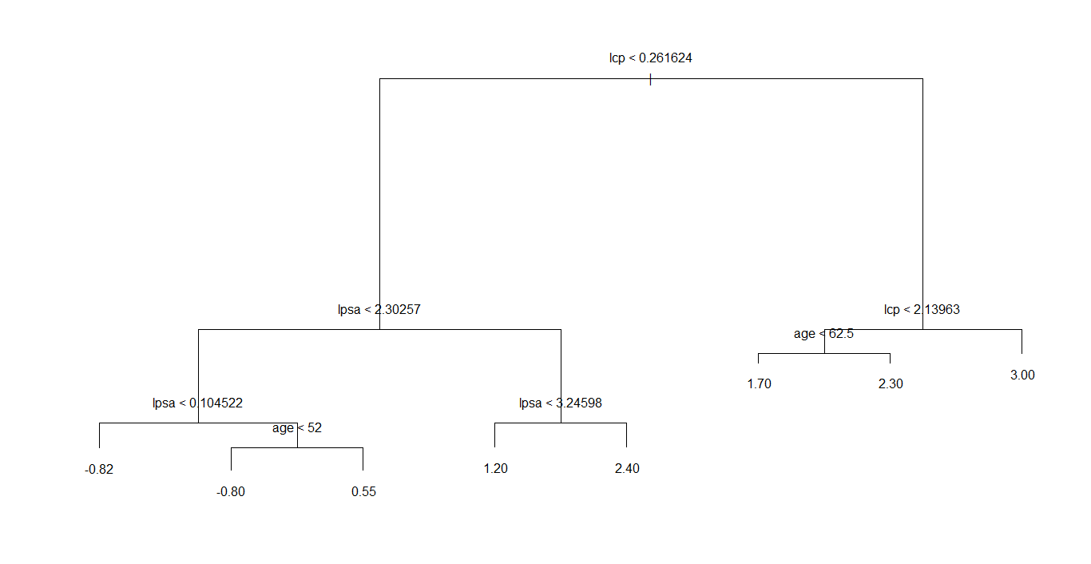
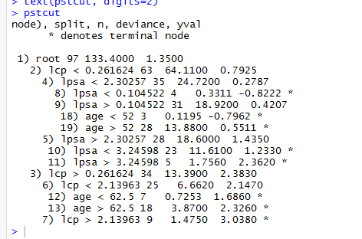
Decision Tree
pstcut <- prune.tree(pstree,k=2.05)
plot(pstcut)
pstcut

Slide 21
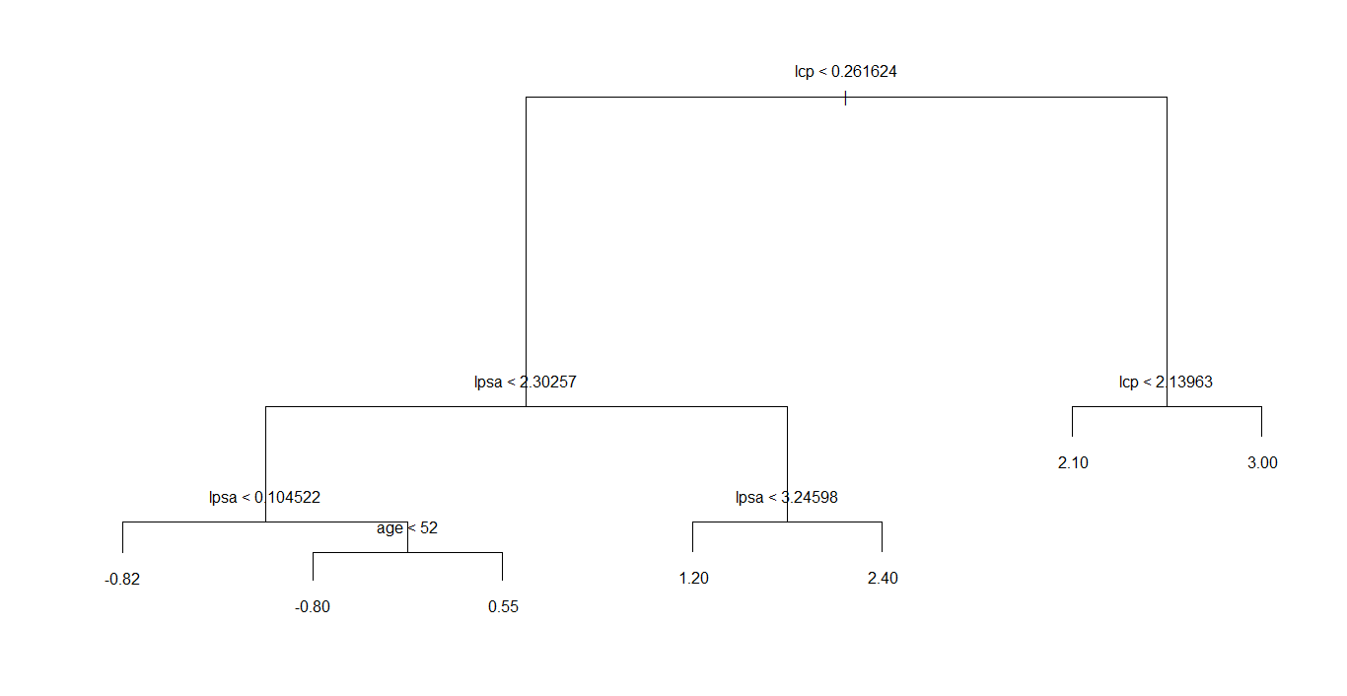
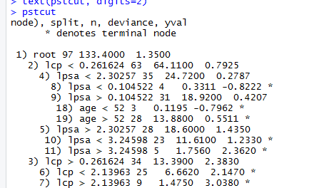
Decision Tree
pstcut <- prune.tree(pstree,k=3)
plot(pstcut)
pstcut

Slide 22
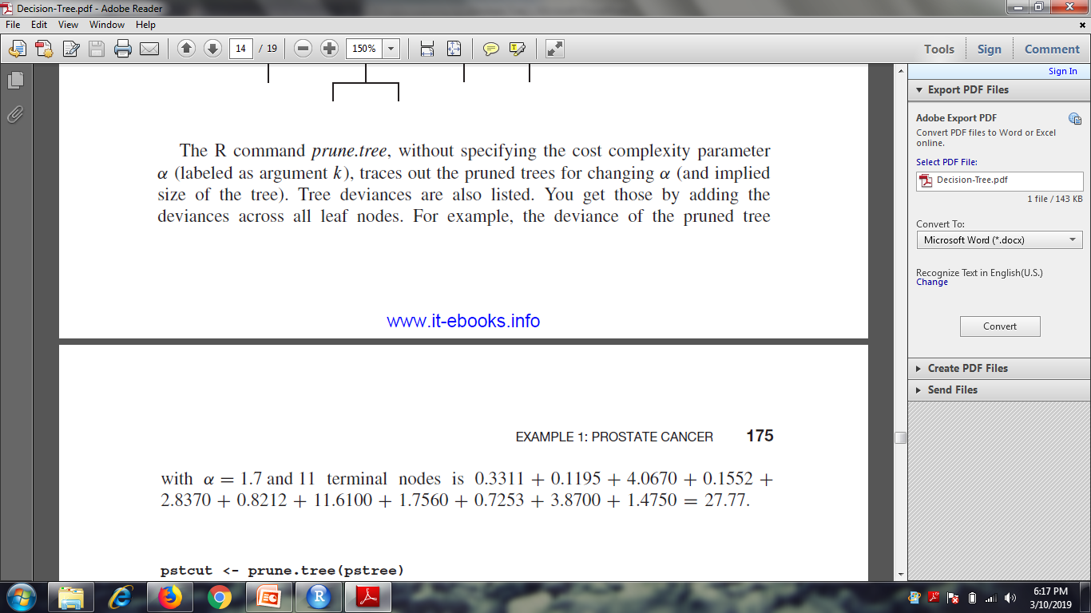
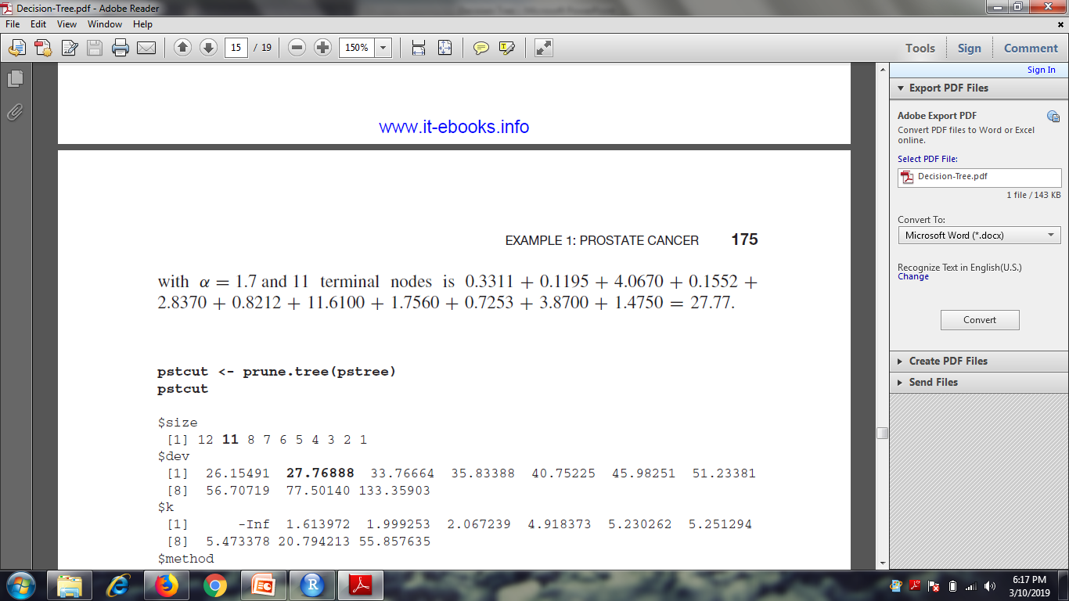
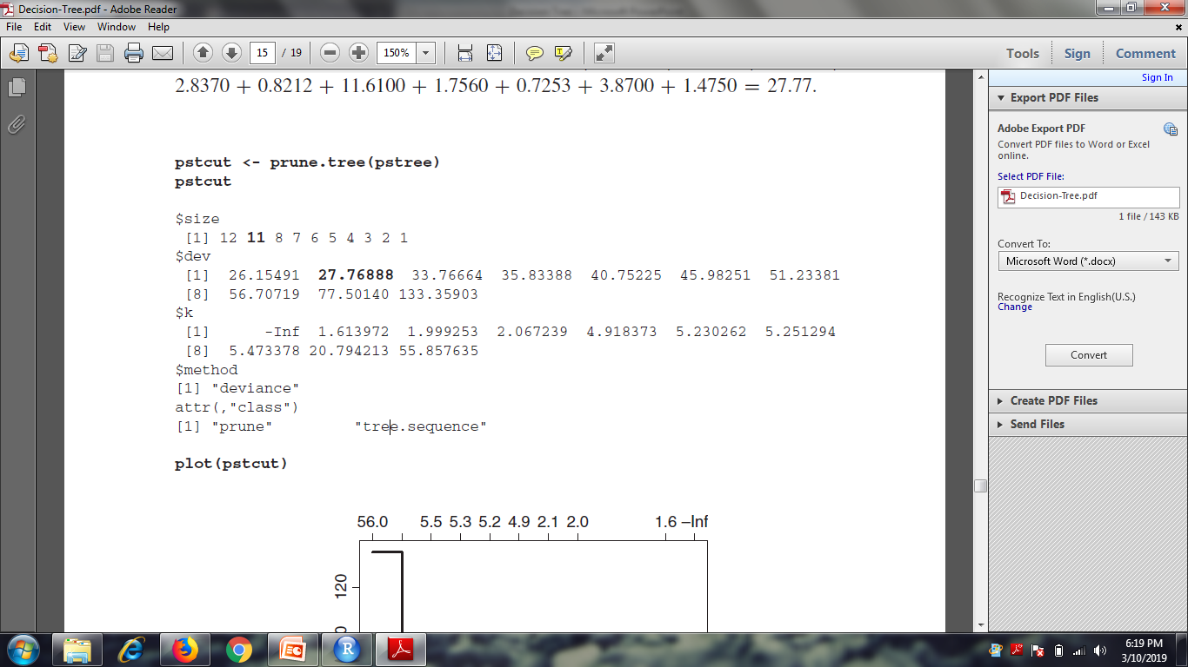
Decision Tree
pstcut <- prune.tree(pstree)
pstcut

Slide 23
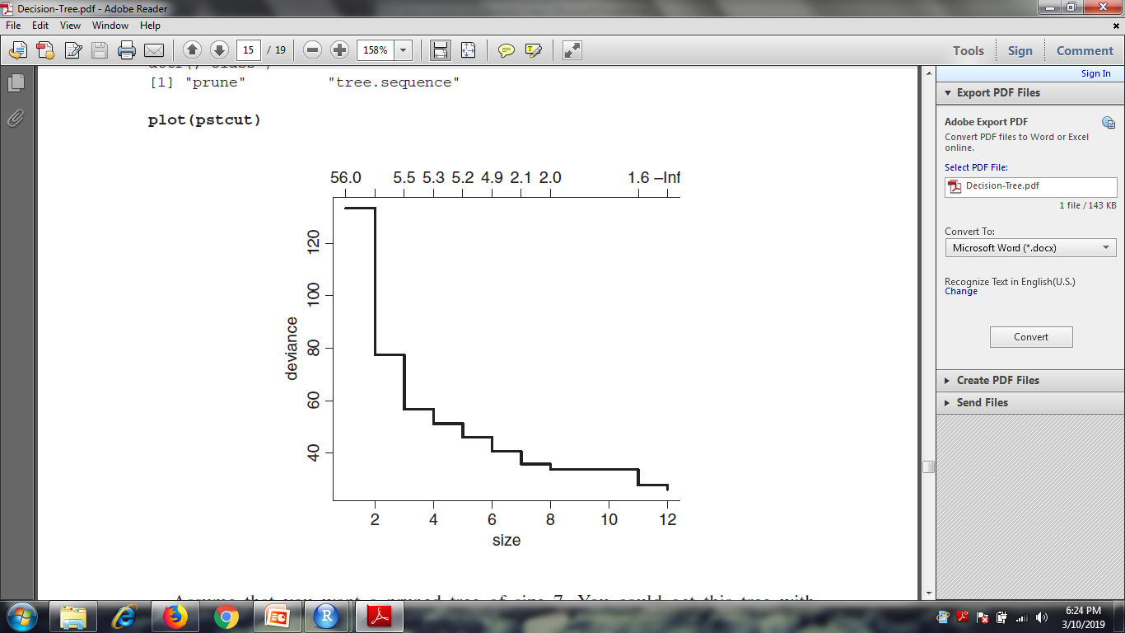
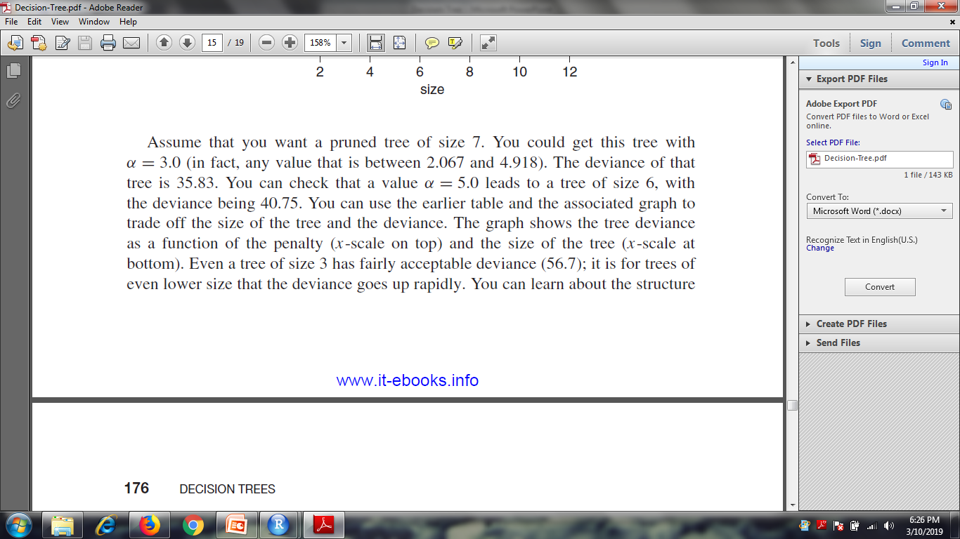
Decision Tree
plot(pstcut)

Slide 24
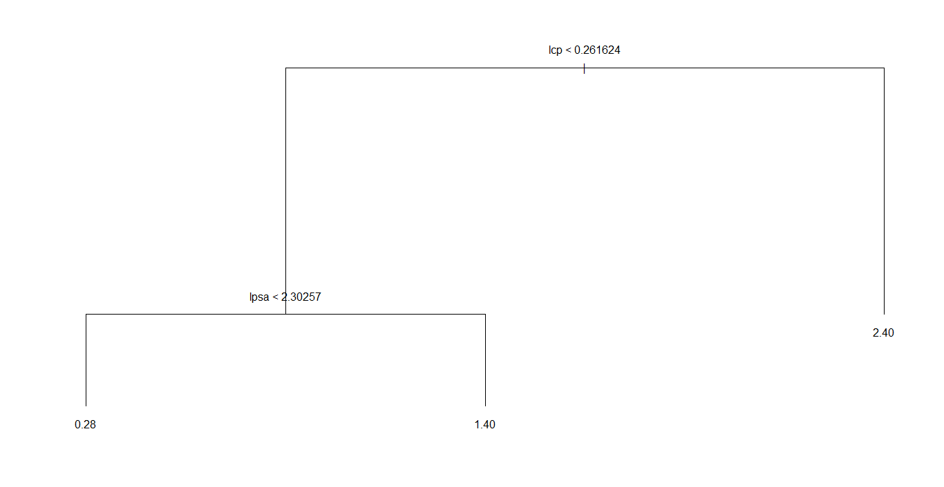
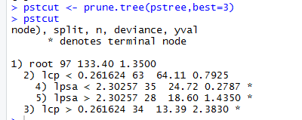
Decision Tree
pstcut <- prune.tree(pstree,best=3)
pstcut
deviance(pstcut)
[1] 56.70719

Slide 25
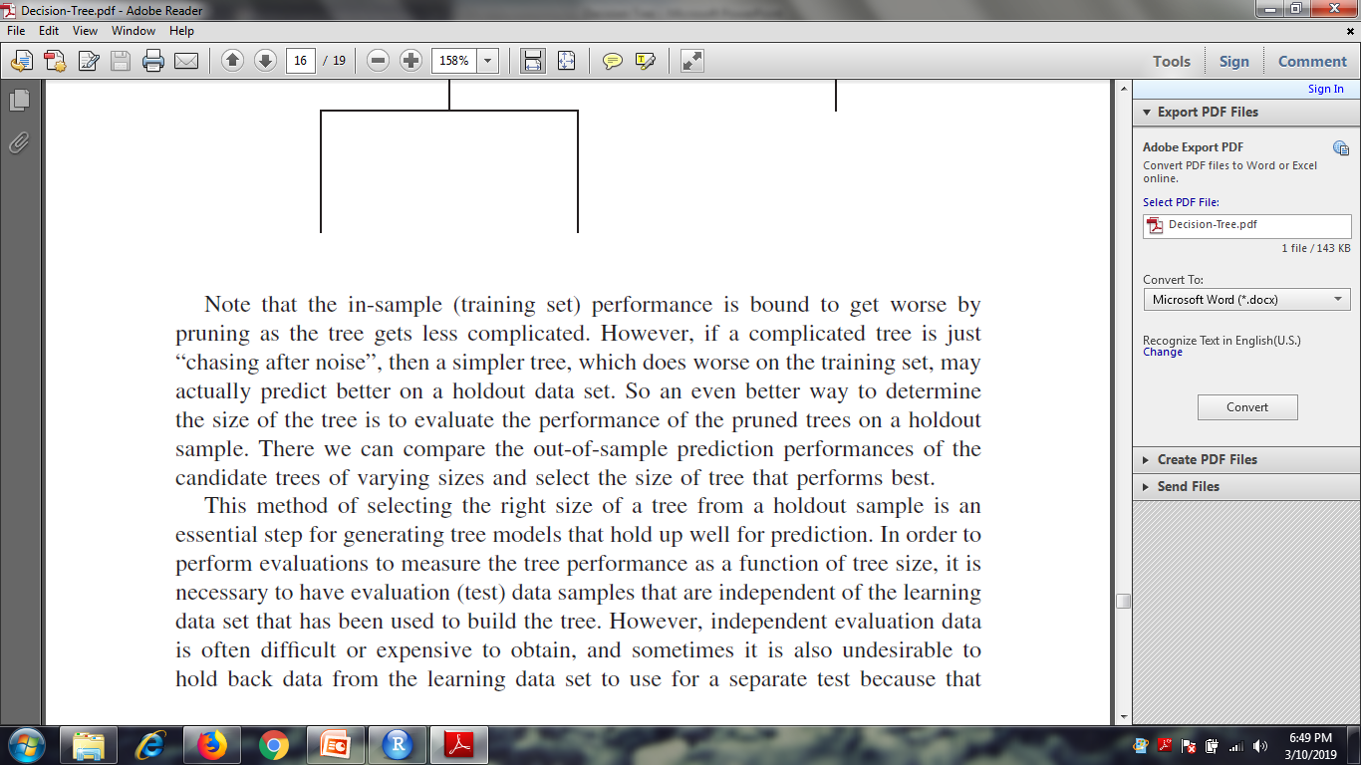
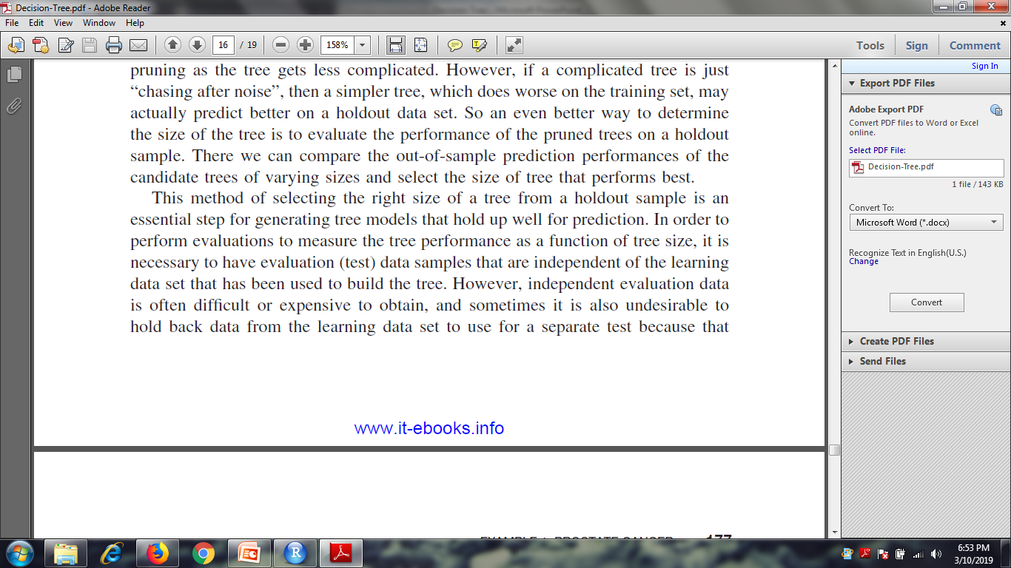

Decision Tree

Slide 26
Decision Tree
All of the rows in the learning data set are used to build the tree.
This tree is intentionally allowed to grow larger than is likely to be optimal.
This is called the reference, or unpruned tree.
Next, the learning data set is partitioned into a certain number of groups called folds
distributions of the target variable are approximately the same in the partitioned groups
. number of groups that the rows are partitioned into is the “V” in “Vfold cross classification.
10 is the recommended default number of partitions.
We combine the rows in nine of the partitions into a new pseudo-learning data set
A test tree is constructed and subsequently pruned, resulting in a set of terminal nodes for each possible tree size.
The 10% (1 out of 10 partitions) of the data that is held and used for an out-of-sample evaluation of the test tree
The 10% of the data that is held back is run through the test tree and the tree’s performance is evaluated at its various class sizes

Slide 27
Decision Tree
Next, a different set of nine partitions is collected into a new pseudo-learning data set.
partition being held back this time is different than the first test tree.
A second test tree is built / pruned and its performance measures are computed using the data that was held back when it was built.
This process is repeated 10 times, building 10 separate test trees
In each case, 90% of the data is used to build a test tree and 10% is held back for a independent testing. A different 10% is held back for each test tree
Once 10 trees are built, their out-of-sample performances, for given tree size, are averaged
averaged error rate for a particular tree size is known as the cross-validation cost (or CV cost).
The tree size that produces the minimum CV cost is found.
The reference tree is then pruned back to the number of nodes matching the size that produces the minimum CV cost
The reference tree that is pruned back to the optimal size determined by CV is the best tree to use for predicting/classifying future data sets.
V-fold CV is carried out with the R command cv.tree

Slide 28
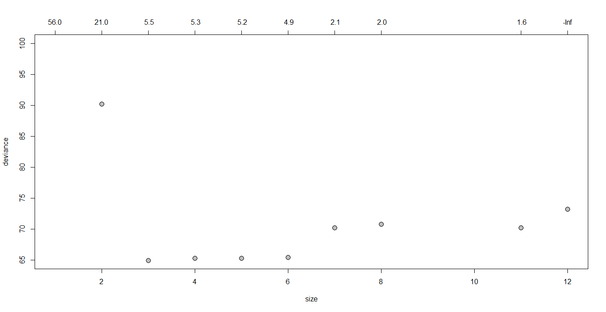
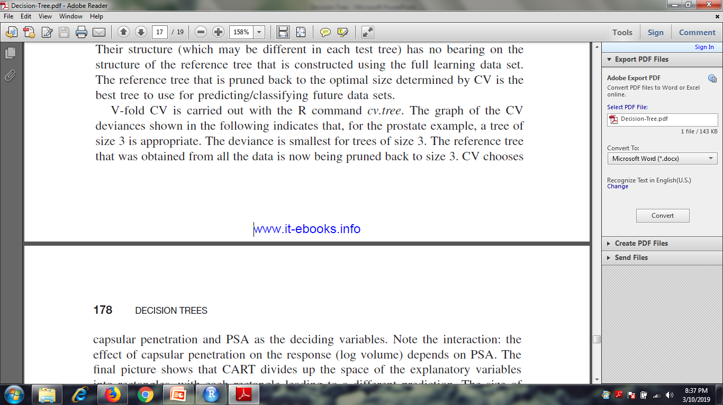
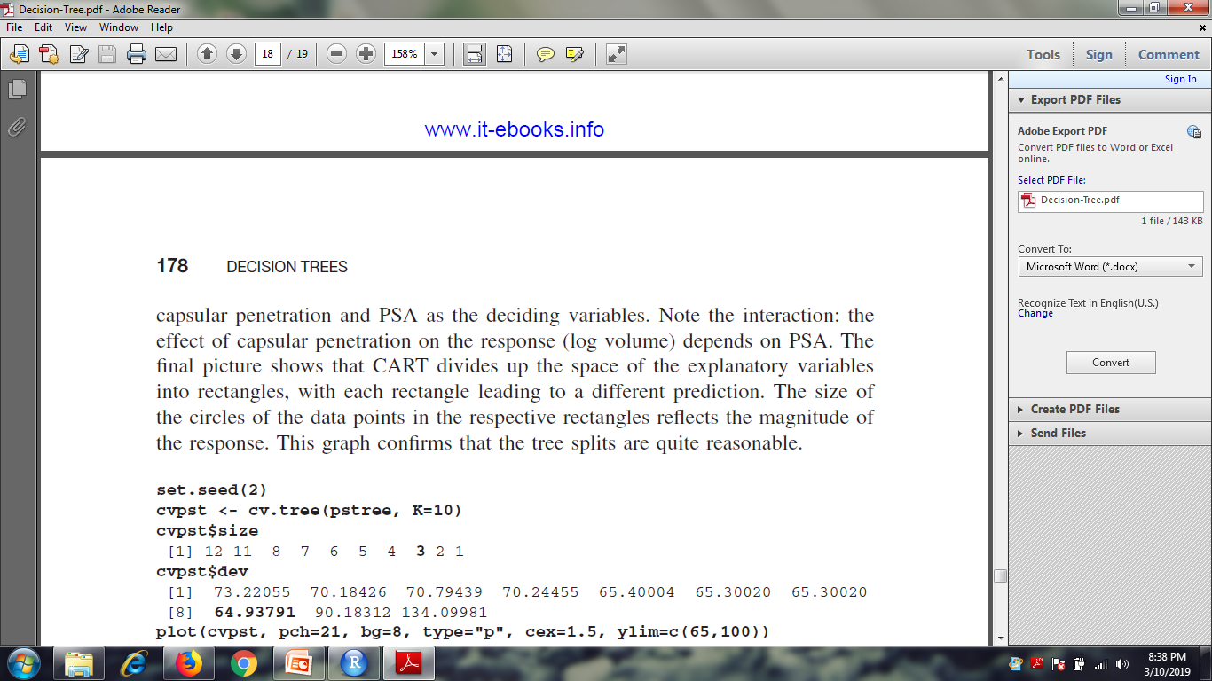
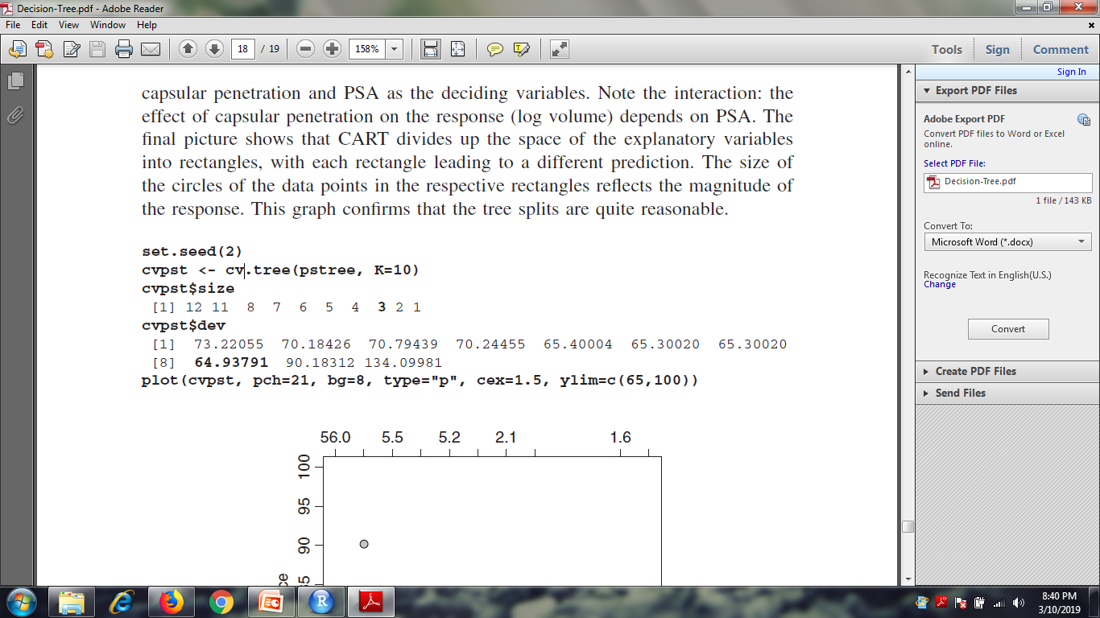
Decision Tree

Slide 29
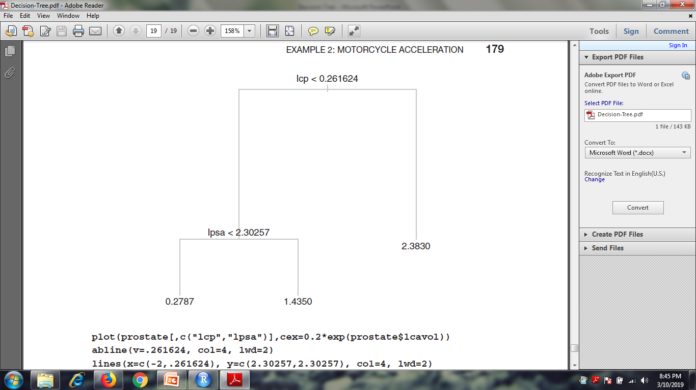
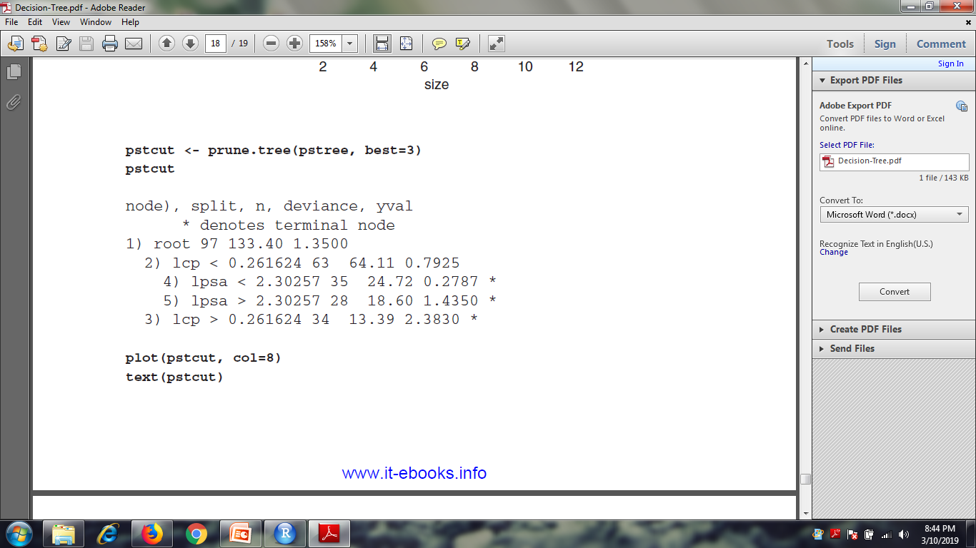
Decision Tree

Slide 30
End

